Slide 1


Bright SALES
Enhancing Sales Strategy
JAN 2026

Slide 2




AGENDA
Analysis Phase
Strategy Proposal
Marketing Cameigns
  Review overall sales performance and historical trends
  Examine quantity sold across weekly, monthly, quarterly, and seasonal dimensions
  Identify margin and cost efficiency challenges
  Outline And Define key actions: portfolio audit, segmentation, incentive realignment, and efficiency improvements
  Establish objectives for sustainable profitability and growth
  Present profit-focused campaign concepts (Smart Value, Premium Picks, Profit Pulse, Seasonal Shift)

Slide 3
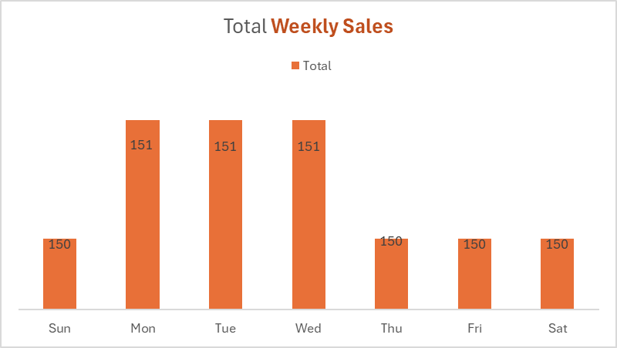
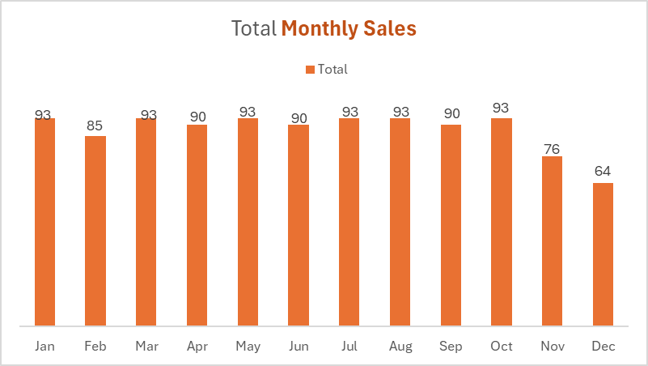
SALES TRENDS
📅 Weekly Sales Insights
  Consistent Sales Pattern: Sales are remarkably stable throughout the week, with only a slight uptick on Monday through Wednesday (151 units) compared to other days (150 units).
  No Clear Peak Day: There's no standout day for higher sales, suggesting customer activity is evenly distributed across the week.
  Operational Implication: Staffing and inventory can likely remain consistent daily, with minimal need for day-specific adjustments.
📆 Monthly Sales Insights
  Peak Months: January, March, May, July, October all hit the highest monthly sales (93 units). These months appear to follow a bi-monthly high pattern.
  Dip in Year-End: November (76) and December (64) show a noticeable decline, which is unusual if these months typically benefit from holiday shopping.
  Mid-Year Stability: April, June, August, and September maintain a steady 90 units, indicating a plateau in mid-year performance.
01

Slide 4
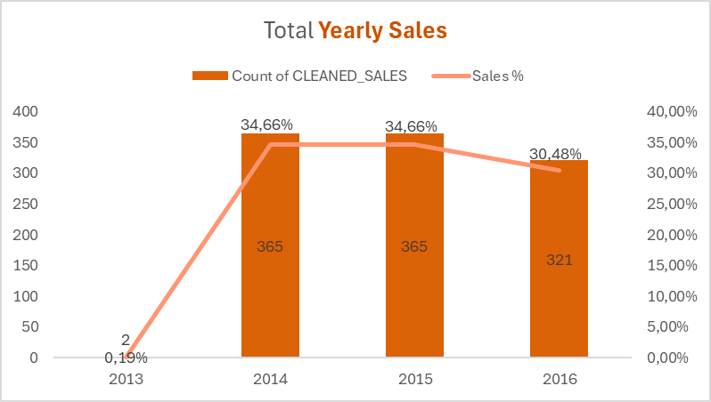
SALES TRENDS
📈 Sales Volume Trends
  2013: Extremely low sales count (2), contributing just 0.19% of total sales. This likely marks the start of data collection or business operations.
  2014 & 2015: Identical performance with 365 sales each year, making up 34.66% of total sales per year. This suggests strong growth and stabilization after the initial year.
  2016: Slight decline to 321 sales, representing 30.48%. While still solid, this drop may indicate emerging challenges or market saturation.
📊 Performance Observations
  Rapid Growth: The jump frm 2 to 365 sales between 2013 and 2014 is dramatic—an increase of over 18,000%. This likely reflects a major expansion or successful launch.
  Plateau in 2015: Maintaining the same sales count as 2014 implies consistent performance but no growth.
  Dip in 2016: A 12% decrease in sales count compared to the previous two years. This could be due to external factors, reduced demand, or internal shifts.
🔍 Strategic Implications
  Investigate 2016 Decline: Understanding what caused the drop competition, pricing, product changes could help reverse the trend.
  Leverage 2014–2015 Success: Analyze what worked during those peak years to replicate or adapt those strategies.
  Consider Diversification: If growth is plateauing, exploring new markets or product lines might reignite momentum.

Slide 5
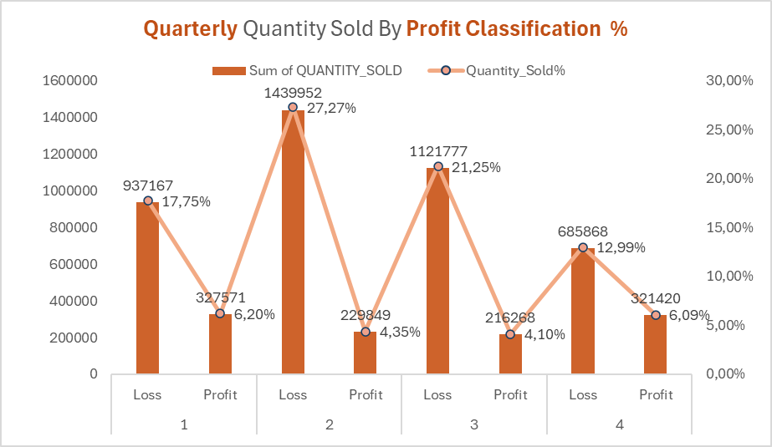
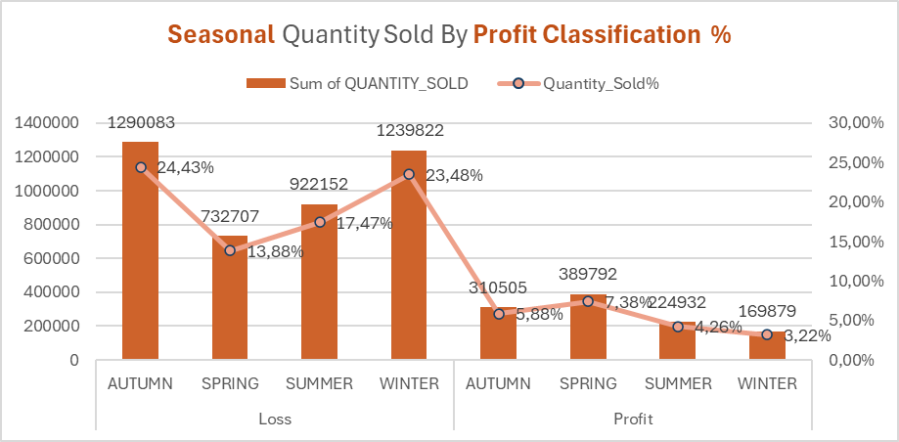
QUANTITY TRENDS
📊 Quarterly Sales Insights
  Dominance of Loss Sales: Across all quarters, the quantity sold under "Loss" classification far exceeds "Profit". For example, Q2 shows the highest loss volume at 1,439,952 units (27.27%), while profit sales are only 229,849 units (4.35%).
  Quarter 2 Risk Zone: Q2 has the highest loss volume and percentage, indicating potential issues with pricing, cost control, or product performance during this period.
  Quarter 4 Improvement: Losses drop significantly in Q4 to 685,868 units (12.99%), while profit sales rise to 321,420 units (6.09%), suggesting better margin management or seasonal demand optimization.
🌤️ Seasonal Sales Insights
  Autumn & Winter Loss Burden: These seasons show the highest loss volumes
  Autumn: 1,290,083 (24.43%),
  Winter: 1,239,822 (23.48%) indicating a need to reassess product mix or pricing strategies during these periods.
  Spring Profit Peak: Spring stands out with the highest profit volume (389,792 units) and percentage (7.38%), suggesting favourable market conditions or successful campaigns.
  Summer Underperformance: Despite moderate loss volume (922,152 units), profit sales are extremely low (4,932 units, 0.26%), pointing to inefficiencies or misaligned offerings.

Slide 6
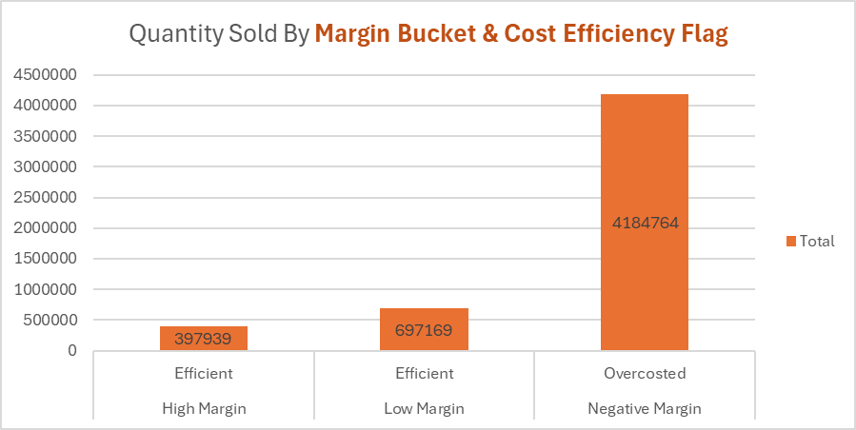
QUANTITY TRENDS
📊 Margin & Cost Efficiency Breakdown
  Overcosted Negative Margin: This category dominates with 4,184,764 units sold, indicating a significant portion of sales are occurring at a loss and with poor cost efficiency.
  Efficient Low Margin: With 697,169 units sold, this segment reflects operational efficiency but limited profitability—possibly due to competitive pricing or low-margin products.
  Efficient High Margin: The smallest segment at 397,939 units sold, yet likely the most profitable per unit, suggesting a niche or premium offering.
🔍 Strategic Observations
  Profitability Risk: The overwhelming volume in the "Overcosted Negative Margin" category signals a major concern high sales volume is not translating into financial health.
  Efficiency vs. Margin Trade-off: While "Efficient Low Margin" has nearly double the volume of "Efficient High Margin", the latter likely contributes more to net profit.
This highlights the need to balance volume with margin.
  Opportunity in High-Margin Efficiency: Scaling the "Efficient High Margin" segment could improve overall profitability without sacrificing operational efficiency.

Slide 7
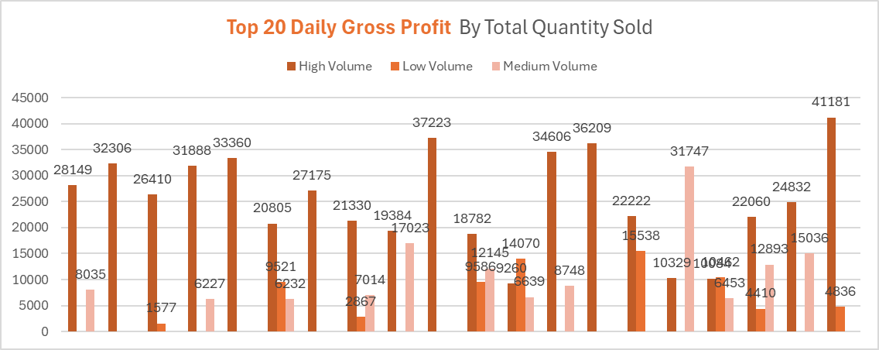
QUANTITY TRENDS
High Volume Drives Gross Profit — But Not Alone
  Every entry includes a High Volume component, confirming that large sales volumes are a major contributor to gross profit.
  However, many days also include Medium and Low Volume contributions, showing that diverse volume tiers can still yield strong profit.
Mixed Volume Days Perform Well
  Several top-performing days (e.g., entries with 3 volume tiers) show balanced contributions:
    Example: One day has High (12K), Medium (9.5K), and Low (9.2K) a well-rounded profit profile.
Medium Volume Surges
  Some days show Medium Volume outperforming High Volume
    Example: Medium (21K) vs. High (20K) indicating that mid-tier SKUs may have better margins or pricing power.
  These are prime candidates for margin-focused campaigns.
Low Volume Still Matters
  Though less frequent, Low Volume bars contribute meaningfully in some cases (e.g., 6K+).
  These may represent premium-priced items or niche products with high unit margins.

Slide 8
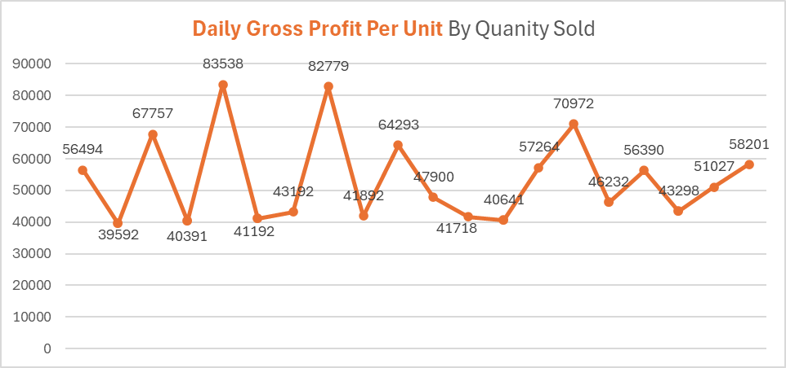
QUANTITY TRENDS
Outlier Days
  The top values (e.g., R83,538 and R82,779) are clear outliers. These may represent:
    High-margin SKUs sold in bulk
    Efficient cost control
    Strategic pricing during promotions
Mid-Range Quantity, Strong Margins
  Several mid quantity days (e.g., 40K–50K range) still deliver unit profits above R50K, showing that volume isn’t the only profitability driver.
High Gross Profit Per Unit Despite High Quantity
  Several data points show gross profit per unit exceeding 70,000, even when quantity sold is high.
  This suggests that high volume days can still maintain strong unit margins, likely due to premium pricing or cost efficiency.
Volatility in Profit Per Unit
  The values fluctuate significantly from 27K to 83K across different quantity levels.
  This indicates that unit profitability is not strictly tied to volume. Some days with similar quantities yield very different profits per unit.

Slide 9
🧾 STRATEGIC PROPOSAL
Objective
To reduce reliance on overcosted negative-margin sales and increase the share of efficient high-margin transactions, thereby improving overall profitability without sacrificing volume.
🔑 Key Actions
📦 Product Portfolio Audit
  Identify SKUs contributing most to overcosted negative-margin sales
  Reassess pricing, cost structure, and demand elasticity
📊 Margin-Based Segmentation
  Classify products into high-margin, low-margin, and negative-margin buckets
  Prioritize marketing and inventory for high-margin efficient products
🤝 Sales Incentive Realignment
  Adjust sales team KPIs to reward margin contribution over volume alone
  Introduce tiered commission structures favouring high-margin sales
⚙️ Operational Efficiency Enhancements
  Streamline supply chain for low-margin products to reduce cost base
  Negotiate better vendor terms for high-performing SKUs
02

Slide 10
📣 MARKET CAMPAIGNS: DRIVING PROFIT-OPTIMIZED GROWTH
1. “Smart Value” Campaign
  Target: Budget-conscious customers
  Focus: Efficient low-margin products with bundled offers
  Channels: Email, SMS, in-app banners
  Message: “Get more for less—smart choices, smarter savings.”
2. “Premium Picks” Campaign
  Target: High-value customers
  Focus: Efficient high-margin products with exclusive perks
  Channels: Social media, influencer partnerships, loyalty programs
  Message: “Elevate your experience—premium products, premium rewards.”
3. “Profit Pulse” Internal Campaign
  Target: Sales and operations teams
  Focus: Educate on margin impact and promote strategic selling
  Channels: Internal newsletters, dashboards, gamified leaderboards
  Message: “Sell smart, earn smarter—every margin counts.”
4. “Seasonal Shift” Campaign
  Target: General consumer base
  Focus: Redirect seasonal demand toward profitable SKUs
  Channels: Seasonal landing pages, retargeting ads
  Message: “New season, new savings—shop smarter this spring.”

Slide 11

CONCLUSION
Focusing on strategic, margin-conscious sales while selling smarter rather than simply selling more is the pathway to achieving sustainable resilience, enhanced profitability, and a lasting competitive advantage.

Slide 12
Thank you
SINDISWA JACHIN SHONGWE

